Slide 1
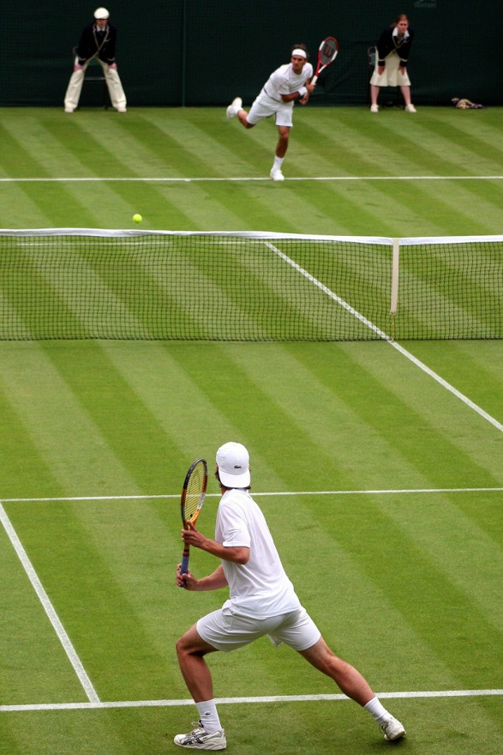
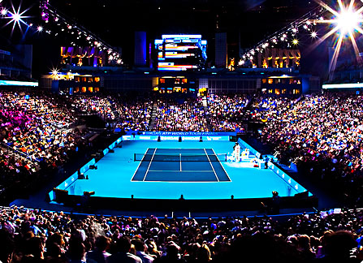
BTS Tennis
A New Form of the Game

Slide 2
What is it all about
Allow Fans to Watch the Best 32 players in the World Compete – Male & Female
Four day competition – One Set Shootouts
No Seedings – Multiple Games each day
Doubles tournament – Pairings Draw at Random
Innovations
Main Aim is Fan Fun

Slide 3
The Concept
Business Model Canvass
Prize Money - Charity
Future of the Event
Fan Interaction
Marketing

Slide 4
Feasibility Study
Areas of Initial Concern
Start Up Cost
Customers
Growth Trajectory
Sustainability of Advantage
Main Target Market - General Sports Fans ( 16-40 Yrs. Olds)
Improved the Feasibility
Market Research
Communication with Sport Fans
Looked at Success of 20/20
Target Governing Bodies

Slide 5
Customer Development
Four week period – To help formulate the structure of the event including innovations in matches , fan activities and double format.
Weeks 1 & 2 – Face to face interactions with 20-30 people ( tennis & general sports fans)
Publish website for public viewing & develop social media presence
Weeks 3- 4 – Analyse feedback on Website Viewing and Social Media Survey to help establish demand and customer wants from the event.

Slide 6
Funding
2-3 million dollars
Marketing – Media Release, attracting sponsors
Establish client relationship – meetings with governing bodies (ATP/WTA) for event approval
Player discussions – get them on board
Venue hire – likely location Sydney or Brisbane
Publicity Events
Staff recruitment – Marketing & Client Liaison (tennis background)

Slide 7
BTS Tennis – Focus is the Fun
More information :
Website – www.tennisscape.weebly.com
Email – thomas.burnell@student.bond.edu.au

Slide 8
References
Association of Tennis Professionals (ATP) - http://www.atpworldtour.com/
Women’s tennis Association (WTA) - http://www.wtatennis.com/page/Home/0,,12781,00.html
Queensland Tennis Centre - http://www.tennis.com.au/qld/events/qtc
Broadcasting rights info - Sport Business International. (2007). WIMBLEDON TV FEES COULD BE SET TO RISE retrieved from http://www.sportbusiness.com/news/162093/wimbledon-tv-fees-could-be-set-to-rise
Tennis Umpiring Information BBC. (n.d). Want to be a tennis umpire? Retrieved from tp://news.bbc.co.uk/sport2/hi/tennis/get_involved/4541821.stm
Tran, M. (2011) A Working Life; An Tennis Umpire retrieved from http://www.guardian.co.uk/money/2011/jun/18/working-life-tennis-umpire

